Slide 1
Gateway Water Management Authority
Who are we?
By Grace J. Kast
Executive Officer
Stormwater Workshop 2016

Slide 2
Background
GWMA is a JPA and is the sister water agency to the Gateway Cities Council of Government “COG”
GWMA was formed in 2007 by 10 cities and the Southeast Water Coalition
GWMA is a Fiduciary and Contractual Agency on Behalf of Watershed Groups and Regional Grant Programs
Membership has grown to 25 Gateway Region Cities and 4 Water Agencies

Slide 3
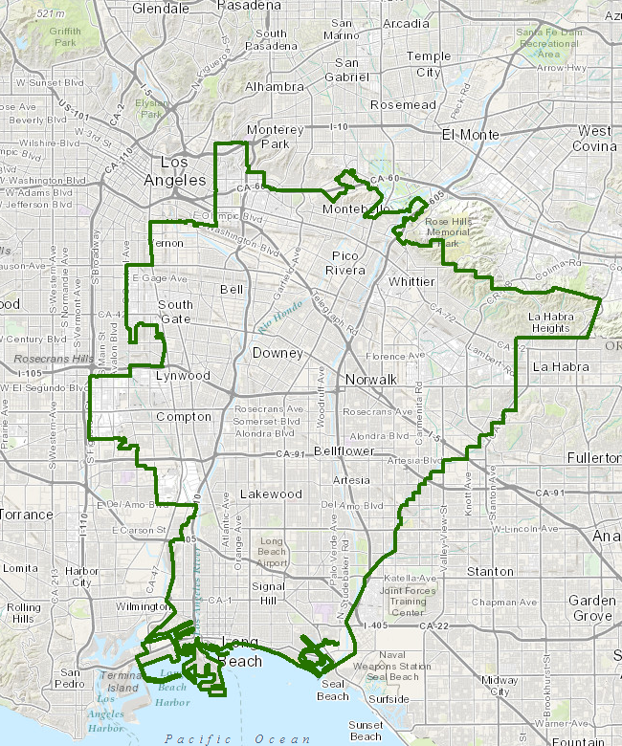
CURRENT GWMA MEMBER AGENCIES/CITIES
Artesia
Avalon
Bell
Bell Gardens
Bellflower
Central MWD
Cerritos
Commerce
Cudahy
Downey
Hawaiian Gardens
Huntington Park
La Mirada
Lakewood
Long Beach
Long Beach Water Department
Lynwood
Maywood
Montebello
Norwalk
Paramount
Pico Rivera
Pico Water District
Santa Fe Springs
Signal Hill
South Gate
Vernon
Water Replenishment District of So. Calif.
Whittier
Technical Participation by LAC Sanitation Districts

Slide 4
What does GWMA do?
GWMA works on regional and multi-benefit watershed planning and projects
Provides fiduciary and administrative services for watershed-based groups (i.e., stormwater groups)
Applies for and administers Federal and State grants for regional, multi-party projects

Slide 5
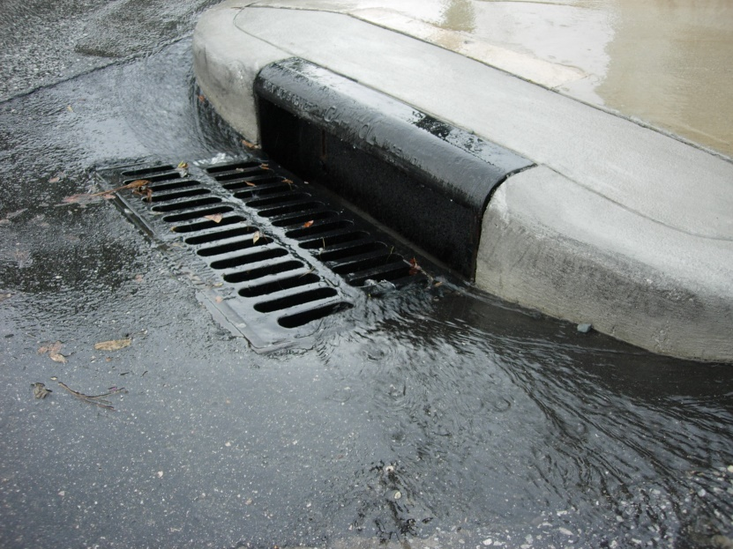
The water picture can mean different things:
Water Supply
Groundwater
Water Conservation/Drought
Reclaimed/Recycled Water
Stormwater and Urban Runoff

Slide 6
GWMA Stormwater Activities
Entered into Memorandum of Understandings “MOUs” with 4 Watershed Groups in the Gateway Region to assist them administratively in meeting regulatory timelines:
- Collect annual funds from group members
- Conduct Request for Proposals
- Enter into contracts
- Pay invoices
- Submit and manage grant applications on their behalf

Slide 7
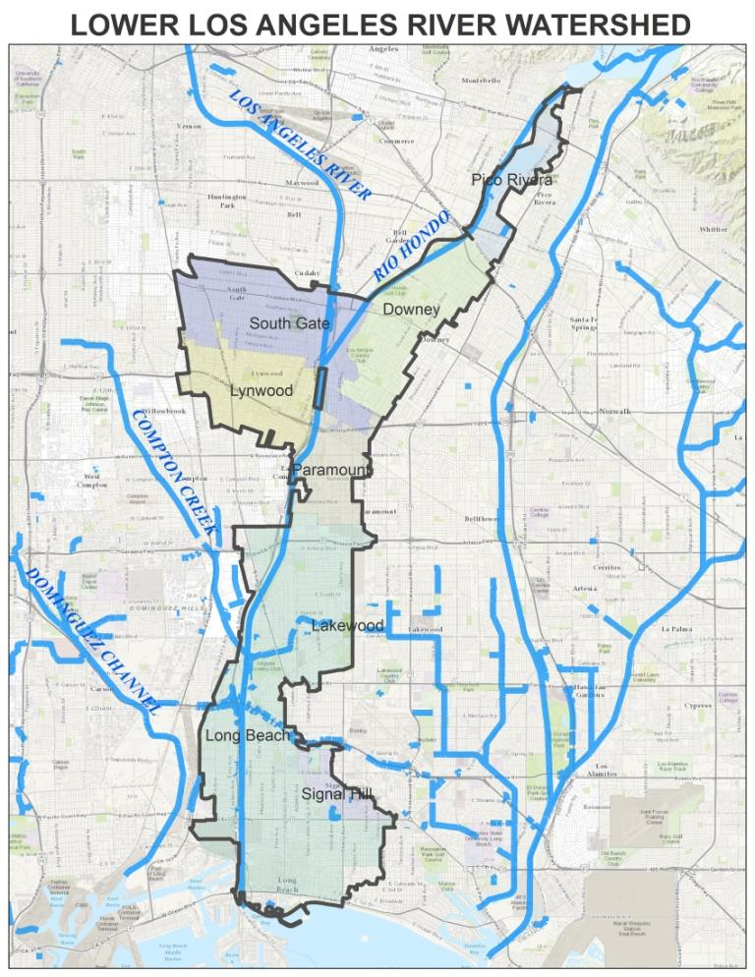
8 Cities and LA County
Downey
Lakewood
Long Beach
Lynwood
Paramount
Pico Rivera
Signal Hill
South Gate
LA County Flood Control District
>$293,000,000

Slide 8
Los Cerritos Channel
7 Cities and LA County
Bellflower
Cerritos
Downey
Lakewood
Long Beach
Paramount
Signal Hill
LA County Flood Control District
>$332,000,000

Slide 9
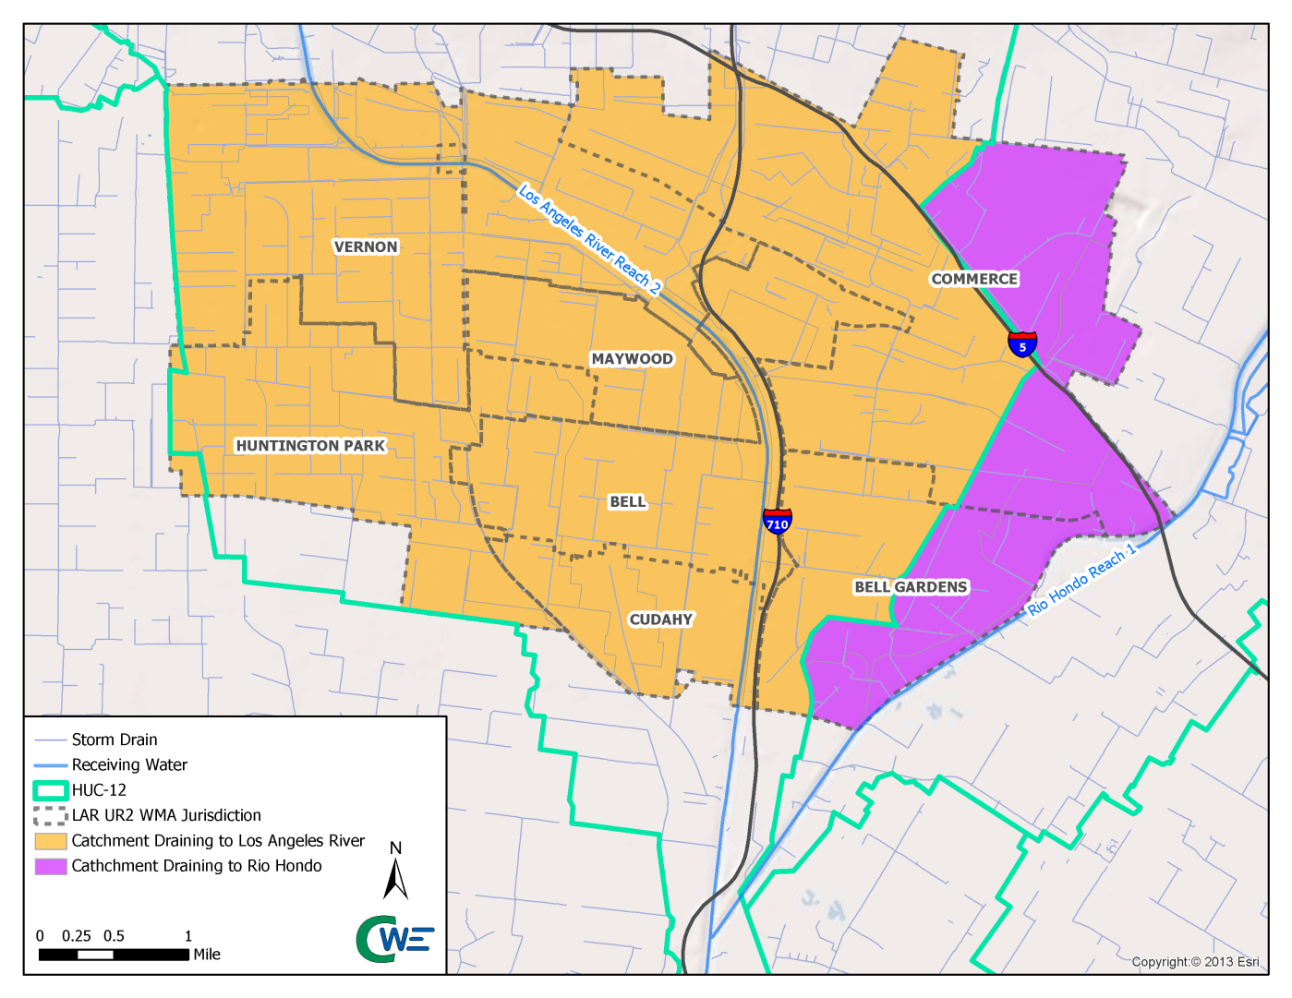
LOWER LOS ANGELES RIVER UPPER REACH 2 (LLAR UR2)
7 Cities and LA County
Bell
Bell Gardens
Commerce
Cudahy
Huntington Park
Maywood
Vernon
LA County Flood Control District
>$310,000,000

Slide 10
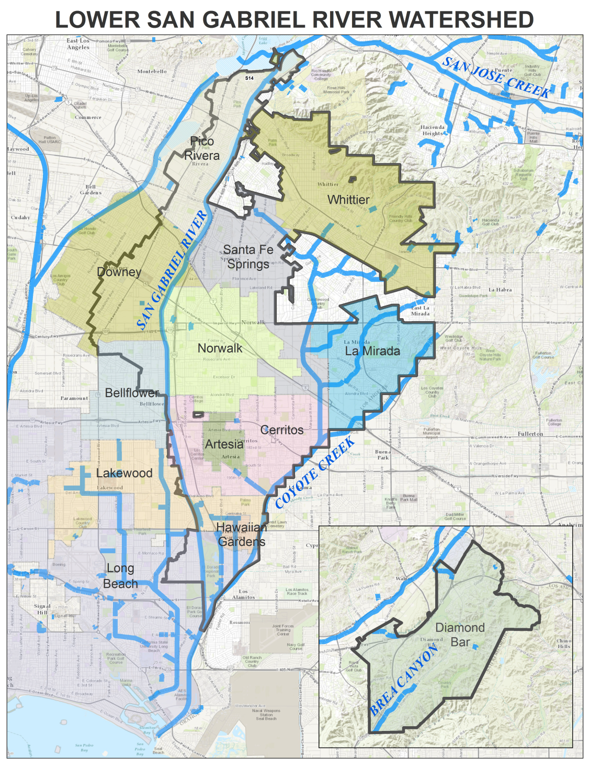
13 Cities and LA County
Artesia
Bellflower
Cerritos
Diamond Bar
Downey
Hawaiian Gardens
La Mirada
Lakewood
Long Beach
Norwalk
Pico Rivera
Santa Fe Springs
Whittier
LA County Flood Control District
>$65,000,000

Slide 11
Stormwater Workshop for Local Officials
Gateway Water Management Authority
October 27, 2016
Stormwater and Watershed Management
Unfunded Mandates
Funding “Tool Box”
By
John Hunter, John L. Hunter & Associates
Ken Farfsing, Carson City Manager

Slide 12
<?xml version="1.0"?><AllQuestions />
<?xml version="1.0"?><Settings><answerBulletFormat>Numeric</answerBulletFormat><answerNowAutoInsert>No</answerNowAutoInsert><answerNowStyle>Explosion</answerNowStyle><answerNowText>Answer Now</answerNowText><chartColors>Use PowerPoint Color Scheme</chartColors><chartType>Horizontal</chartType><correctAnswerIndicator>Checkmark</correctAnswerIndicator><countdownAutoInsert>No</countdownAutoInsert><countdownSeconds>10</countdownSeconds><countdownSound>TicToc.wav</countdownSound><countdownStyle>Box</countdownStyle><gridAutoInsert>No</gridAutoInsert><gridFillStyle>Answered</gridFillStyle><gridFillColor>0,0,0</gridFillColor><gridOpacity>100%</gridOpacity><gridTextStyle>Keypad #</gridTextStyle><inputSource>Response Devices</inputSource><multipleResponseDivisor># of Responses</multipleResponseDivisor><participantsLeaderBoard>5</participantsLeaderBoard><percentageDecimalPlaces>0</percentageDecimalPlaces><responseCounterAutoInsert>No</responseCounterAutoInsert><responseCounterStyle>Oval</responseCounterStyle><responseCounterDisplayValue># of Votes Received</responseCounterDisplayValue><insertObjectUsingColor>Blue</insertObjectUsingColor><showResults>Yes</showResults><teamColors>User Defined</teamColors><teamIdentificationType>None</teamIdentificationType><teamScoringType>Voting pads only</teamScoringType><teamScoringDecimalPlaces>1</teamScoringDecimalPlaces><teamIdentificationItem></teamIdentificationItem><teamsLeaderBoard>5</teamsLeaderBoard><teamName1></teamName1><teamName2></teamName2><teamName3></teamName3><teamName4></teamName4><teamName5></teamName5><teamName6></teamName6><teamName7></teamName7><teamName8></teamName8><teamName9></teamName9><teamName10></teamName10><showControlBar>Slides with Get Feedback Objects</showControlBar><defaultCorrectPointValue>100</defaultCorrectPointValue><defaultIncorrectPointValue>0</defaultIncorrectPointValue><chartColor1>187,224,227</chartColor1><chartColor2>51,51,153</chartColor2><chartColor3>0,153,153</chartColor3><chartColor4>153,204,0</chartColor4><chartColor5>128,128,128</chartColor5><chartColor6>0,0,0</chartColor6><chartColor7>0,102,204</chartColor7><chartColor8>204,204,255</chartColor8><chartColor9>255,0,0</chartColor9><chartColor10>255,255,0</chartColor10><teamColor1>187,224,227</teamColor1><teamColor2>51,51,153</teamColor2><teamColor3>0,153,153</teamColor3><teamColor4>153,204,0</teamColor4><teamColor5>128,128,128</teamColor5><teamColor6>0,0,0</teamColor6><teamColor7>0,102,204</teamColor7><teamColor8>204,204,255</teamColor8><teamColor9>255,0,0</teamColor9><teamColor10>255,255,0</teamColor10><displayAnswerImagesDuringVote>Yes</displayAnswerImagesDuringVote><displayAnswerImagesWithResponses>Yes</displayAnswerImagesWithResponses><displayAnswerTextDuringVote>Yes</displayAnswerTextDuringVote><displayAnswerTextWithResponses>Yes</displayAnswerTextWithResponses><questionSlideID></questionSlideID><controlBarState>Expanded</controlBarState><isGridColorKnownColor>True</isGridColorKnownColor><gridColorName>Yellow</gridColorName><AutoRec></AutoRec><AutoRecTimeIntrvl></AutoRecTimeIntrvl><chartVotesView>Percentage</chartVotesView><chartLabelsColor>0,0,0</chartLabelsColor><isChartLabelColorKnownColor>True</isChartLabelColorKnownColor><chartLabelColorName>Black</chartLabelColorName><chartXAxisLabelType>Full Text</chartXAxisLabelType></Settings>
<?xml version="1.0"?><AllAnswers />
Stormwater and Watershed Management
Source: http://www.ewqa.org/

Slide 13
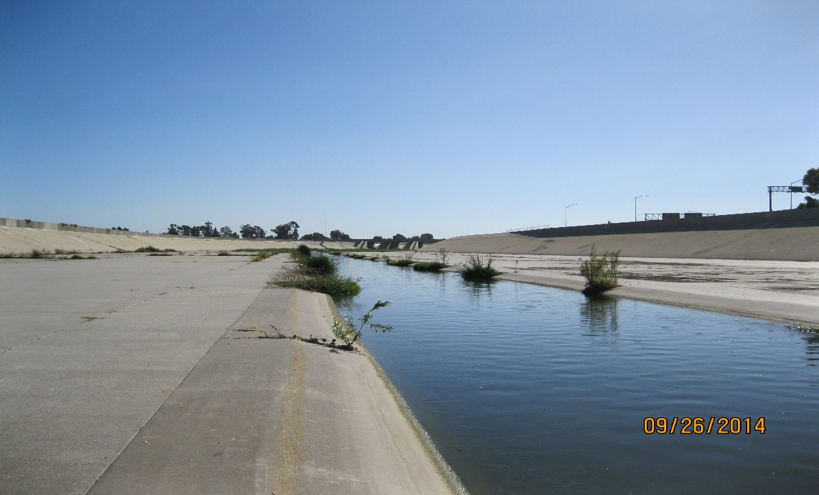
But Most of the Time…

Slide 14
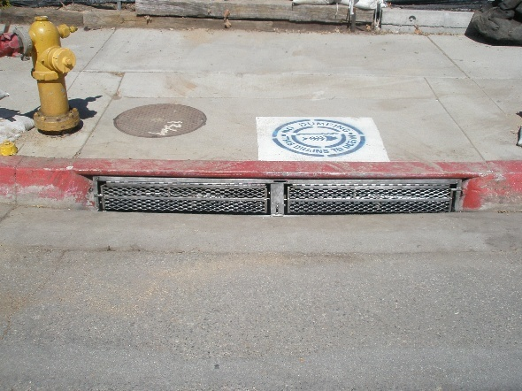
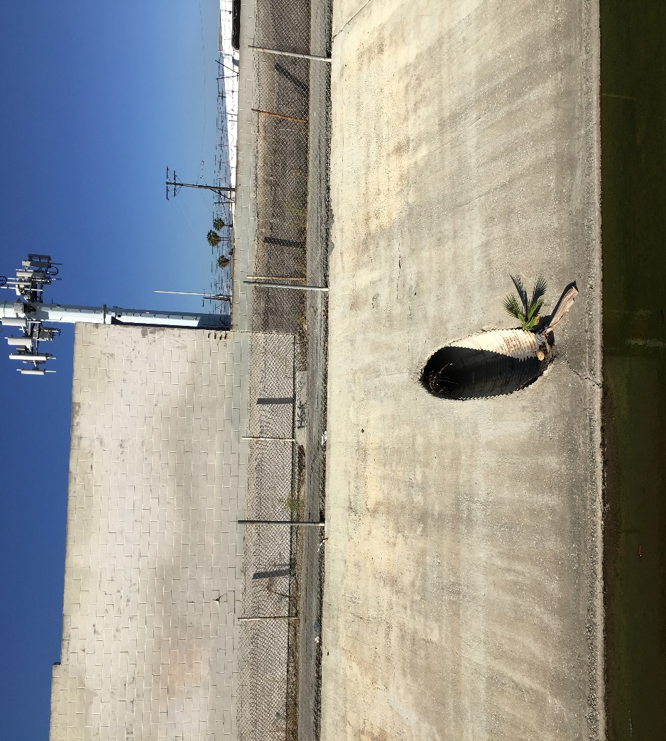
How Water Enters Rivers

Slide 15
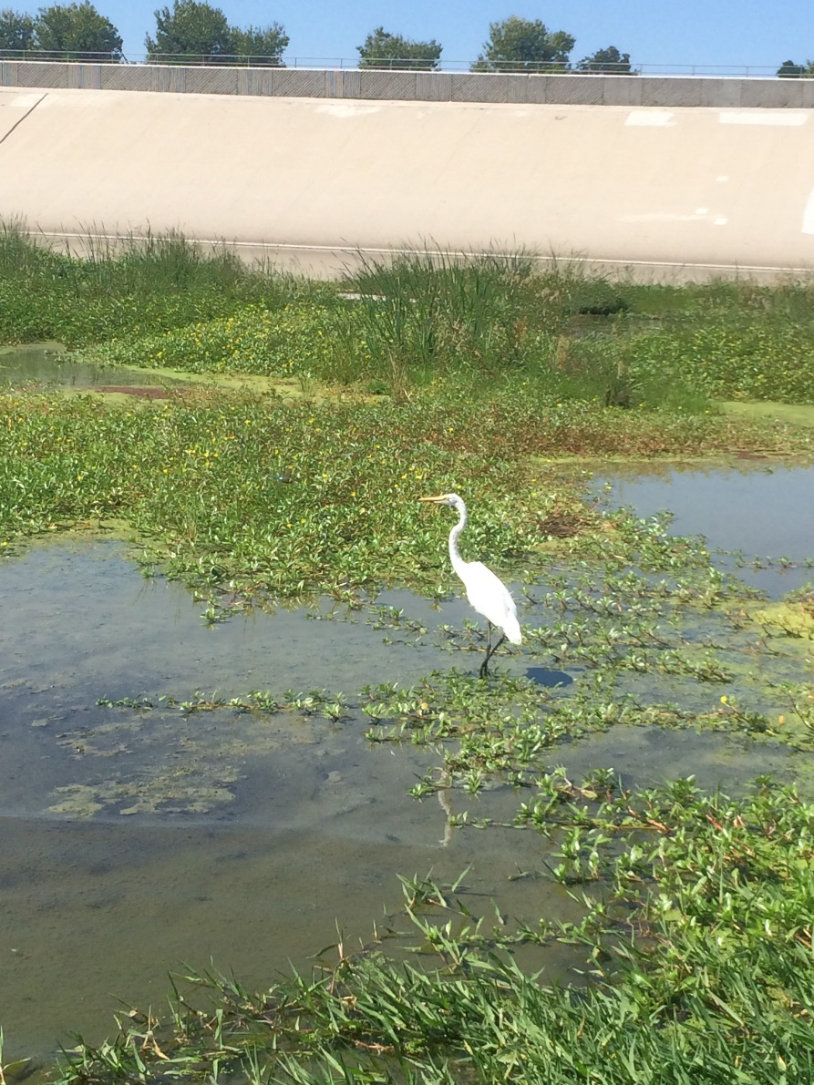
Despite the Concrete, there is Wildlife

Slide 16
Clean Water Act (Fed)
1972
Porter Cologne Water Quality Act (CA)
1969
EPA – NPDES
Storm Water Quality
1987
First MS4 Permit
LA Regional Water Quality Control Board
1991
4th MS4 Permit
2012
WMP and CIMP approved 2015
Once again, California led the way
Under both the FCWA and Porter Cologne, municipalities must obtain a permit to operate the storm drain system

Slide 17
What is MS4?
MS4 is your storm drain system
The MS4 Permit is required to discharge water (rainwater or dry flow) to the Storm Drain System
Municipal Separate Storm Sewer System

Slide 18
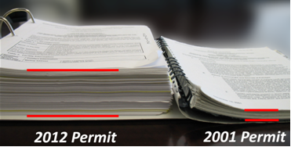
2012 vs. 2001 Permit

Slide 19
The 2012 Permit
Much more comprehensive than the prior Permit
Introduced the concept of Watershed Management
Cities were given the choice of:
Immediate compliance with strict numerical limits
OR
Developing a Watershed Management Program ((E)WMP) to extend final compliance deadlines into the 2020s and 2030s

Slide 20
What is a Watershed Management Program?
A comprehensive evaluation of the water quality of a watershed area
A strategy for meeting the goals of the MS4 Permit, specific projects, and specific schedules

Slide 21
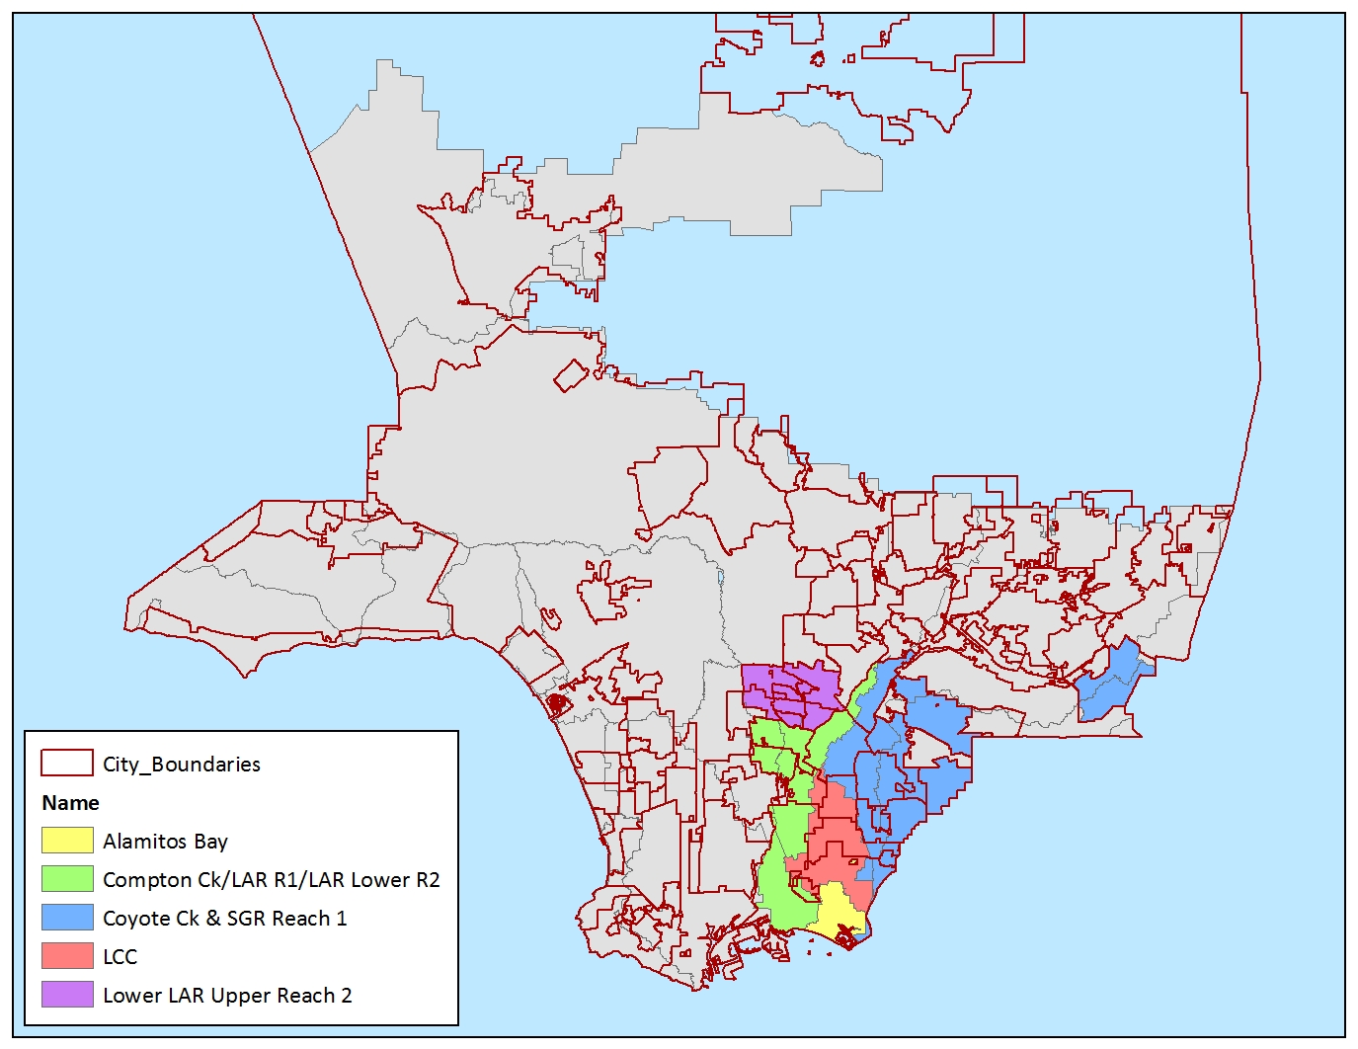
Los Angeles County Watersheds

Slide 22
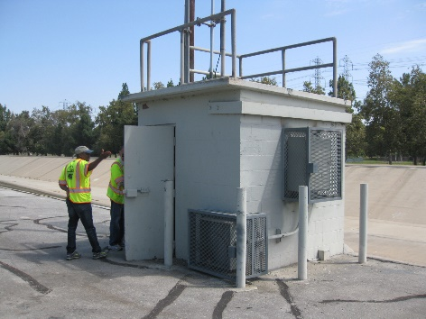
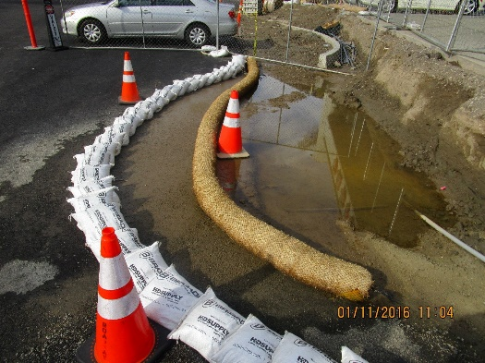
Timelines and Targets
Monitoring
Inspections

Slide 23
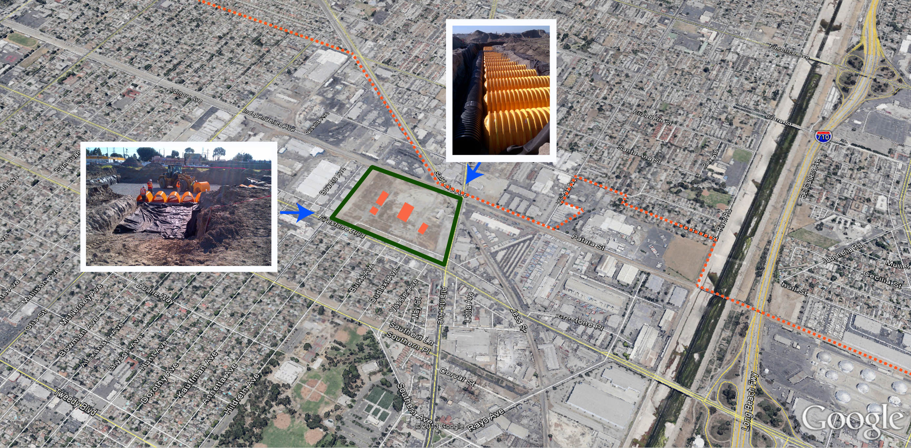
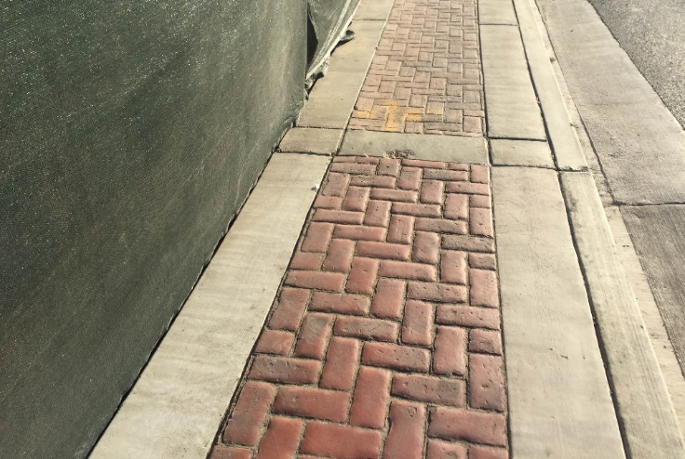
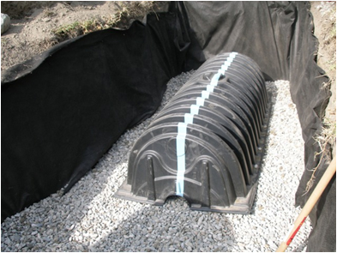
The Permit’s Big Push Low Impact Development (LID)
BMPs
Regional Projects
Other Small Scale LID Projects

Slide 24
Why not just put all the runoff into the ground?
Need to avoid groundwater contamination
Source:

Slide 25
Success Stories (soon)
Lakewood: Bolivar Park
Signal Hill/ Long Beach Airport
Long Beach MUST
Prop 84
Challenges still to come:
- Estimated to cost $20 billion through County

Slide 26
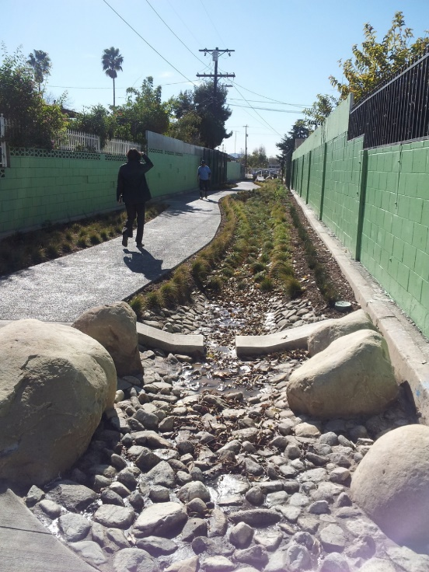
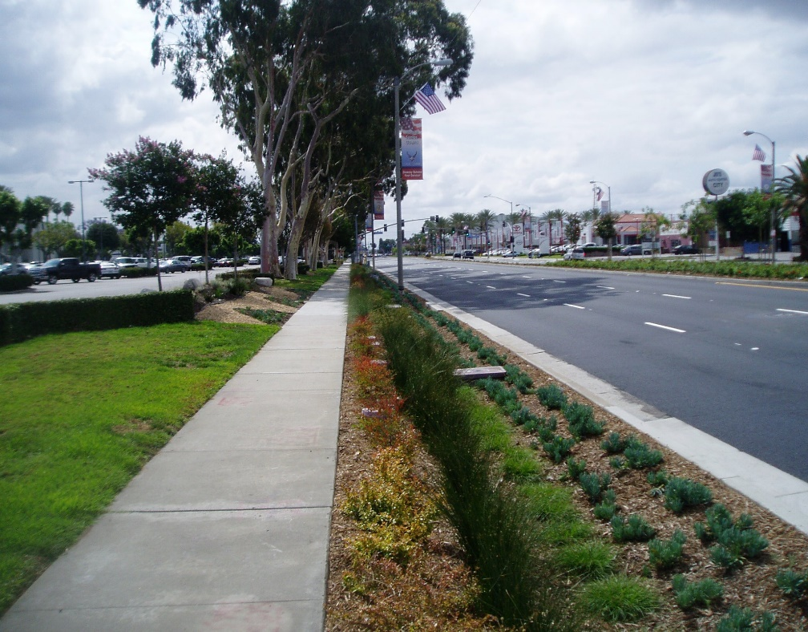
Prop 84
Pacoima
Downey
Whittier

Slide 27
Next: Funding
Editor.photoshop.com

Slide 28
Unfunded Mandates
Department of Finance v. Commission on State Mandates, California Supreme Court Case No. S214855
Narrow decision – focused on test claims filed on the 2001 NPDES Permit (costs of inspections & trash receptacles)
LA County and 7 Cities (Bellflower, Carson, Commerce, Downey, Norwalk, Rancho Palos Verdes and Signal Hill) funded the litigation, which began with a test claim in 2002.
Cities may be reimbursed if they have no other source of funding other than tax revenues for these obligations

Slide 29
Court Decision means…
Decision does not address to what extent cities will receive reimbursement and does not relieve cities of compliance with NPDES Permit
The case has been sent back to the Superior Court
State Mandates Commission:
suspended action on the 2012 claims pending the court decision
should take up these test claims early next year
Yet to be determined: To what extent the Supreme Court’s decision supports the test claims filed under the 2012 NPDES Permit

Slide 30
Stormwater Costs & Funding
Cities are seeking ways to share costs in meeting water quality standards (ex: watershed groups to cost share on monitoring and project construction)
Clean-up task is MASSIVE! (need significant time & resources)
Other major regional environmental issues have taken decades of work (i.e. drinking water, sanitary sewer, air quality improvements)
No single source of revenue will be sufficient to solve the pollution problems
Runoff water should be viewed as a resource to our water supply!

Slide 31
Possible Funding Alternatives?
Amendments to refuse contracts/street sweeping contracts
NPDES Catch Basin Cleaning Fee
AB 2403
SB 485
Caltrans Statewide NPDES Permit
Enhanced Infrastructure District Financing
Community Facilities Districts
Los Angeles County Traffic Improvement Plan – Measure M
County Park Bond- Measure A
LA County Water Resilience Fee Program

Slide 32
Funding Alternative?
Amendments to refuse contracts/street sweeping contracts
There is a direct connection between street sweeping and refuse collection and the deposition of trash reaching the local storm drains
Cities have been negotiating requirements into the refuse franchises and street sweeping contracts to provide funding for catch basin cleaning and additional street sweeping

Slide 33
Funding Alternative?
NPDES Catch Basin Cleaning Fee
Cities have the ability to adopt property assessments to fund catch basin cleaning, through the Proposition 218 process
The process requires the completion of an Engineer’s report documenting the connection between trash deposited on the highways and local refuse collection
The City Council must conduct a “notice and protest hearing”

Slide 34
Funding Alternative?
AB 2403
Expanded the definition of “water” in Section 53750 of the Government Code to “any system of improvements, intended to provide for the production, storage, treatment or distribution of water from any source”
Cities with municipal water utilities should examine the benefits of relying on Section 53750 to implement storm water capture and reuse projects

Slide 35
Funding Alternative?
SB 485
Permits the Los Angeles County Sanitation Districts to partner with a city or group of cities to implement stormwater projects
Districts can provide planning, design construction management and construction of facilities
Especially helpful for cities implementing dry weather diversions to the sanitary sewer system
Carson has entered into an agreement with the Districts to provide design and construction management services for a stormwater capture project in Carriage Crest Park

Slide 36
Funding Alternative?
Caltrans Statewide NPDES Permit
A 2014 amendment to the Caltrans NPDES Permit encourages Caltrans to fund local stormwater quality projects through Cooperative Implementation Agreements
Projects have to address TMDL’s and be on a waterbody priority list
2015-2016 projects included funding for projects in the cities of Carson, Lakewood and Long Beach through Cooperative Implementation Agreements with Bellflower, Carson, Lakewood, Long Beach and Signal Hill

Slide 37
Funding Alternative?
Enhanced Infrastructure District Financing
Cities can form EIFD’s under Government Code Section 53398 and stormwater improvements are specifically allowed
Districts rely on tax increment to fund projects
Bonds can be issued up to 45 years in duration
If the EIFD comprises less than 12 registered voters, district can be formed by a vote of the land owners; each land owner gets on vote per acre
EIFD’s are viable with major development projects and where cities are revitalizing areas of their community through upzoning

Slide 38
Funding Alternatives?
Community Facilities Districts
Cities can form a CFD under Government Code Section 53311
The CFD statute allows the “construction of storm control facilities, including, but not limited to storm drains, detentions, catch basins and appurtenant facilities
CFD’s levy a property tax assessment to finance projects (i.e. bonds)
Like an EIFD, if the district comprises less than 12 registered voters, there is land owner vote
CFD’s are also viable with major development projects and where cities are considering “up zoning” properties

Slide 39
Funding Alternative – Measure M?
Los Angeles County Traffic Improvement Plan
County electorate will decide on Measure M on November 8th
Raises sales taxes countywide by .5% to fund transit and transportation projects (the .5% sales tax in Measure R will become permanent as well for a total of 1%)
Local Return program starts at 17% (based on per capita formula) and increases to 20% in 2039
5% of the 17% can be use to fund Complete Green Streets and other stormwater projects related to transit and transportation projects

Slide 40
Funding Alternative: County Park Bond- Measure A
Safe Clean Neighborhood Parks, Open Spaces, Beaches, Rivers Protection, and Water Conservation Measure
LA County voters will decide on Measure A on November 8th to renew park assessment
The tax rate is $0.03 per square foot of building area (current assessment)
There is a “local return” component of approximately 35% to each city and includes an “operational and maintenance” component
Can be used for park and open space improvements, including capture and reuse of stormwater

Slide 41
LA County Water Resilience Fee Program
The County Board adopted a motion
Expected to include a fee that would to fund stormwater projects

Slide 42
Questions?
Source: https://chirotalk.files.wordpress.com/2015/06/water1.jpg

